Slide 1

Perspectively Projecting Orbits Chuck Noble, Gamergenic

Slide 2
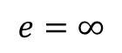
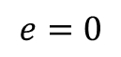
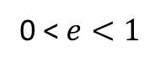
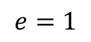
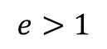
“Classical”/Keplerian/Oscullating Orbits are simple conic sections
“Classical” Orbits
 | Eccentricity (e)
Circle | 0
Ellipse | [0,1]
Parabola | 1
Hyperbola | >1
Line (degenerate case) | Infinity
0 < $ⅇ<1$
$$ⅇ=1$$
$$ⅇ>1$$
$$ⅇ=∞$$
$$ⅇ=0$$
Perspectively Projecting Orbits Chuck Noble

Slide 3
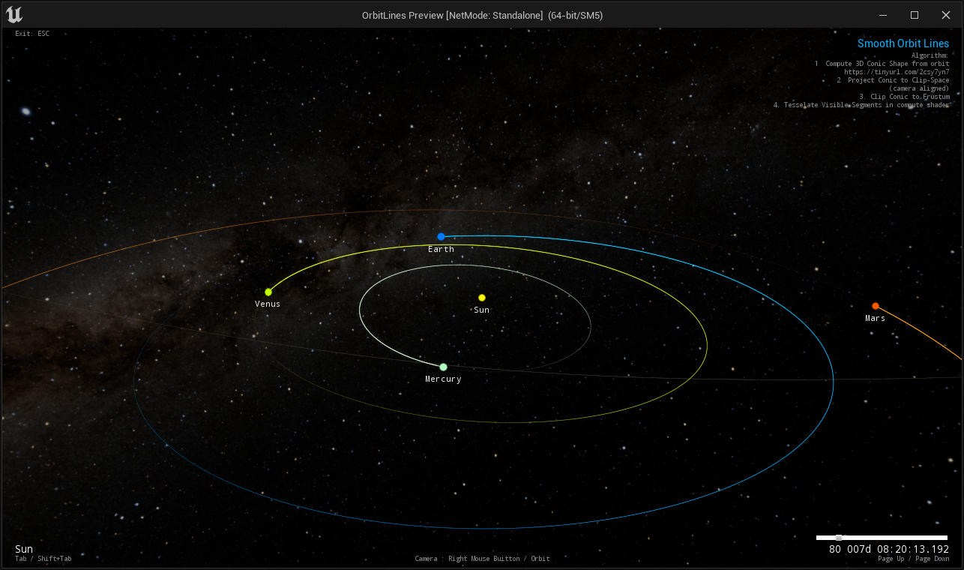
Elliptical Orbits

Slide 4
3D Rendering
3D Orbit visualizations are rendered into a frustum.
Bounded by 6 planes
Perspectively Projecting Orbits Chuck Noble

Slide 5
Perspective Projection
3D Scene
+
Perspective Projection
=
Projection on 2D Plane
Perspectively Projecting Orbits Chuck Noble

Slide 6
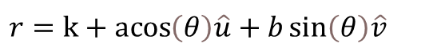
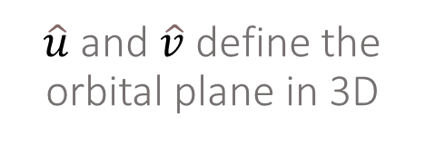
Conic Equations
In 3D space, the orbital path follows a conic equation.
For example, an ellipse
$$r=k+acos\left(θ\right)\hat{u}+b\sin\left(θ\right)\hat{v}$$
$\hat{u}$ and $\hat{v}$ define the orbital plane in 3D
Perspectively Projecting Orbits Chuck Noble

Slide 7
Fun Facts
The perspective projection of a conic section is:
A conic section!
An elliptical orbit
Is usually an elliptical projection
Perspectively Projecting Orbits Chuck Noble

Slide 8
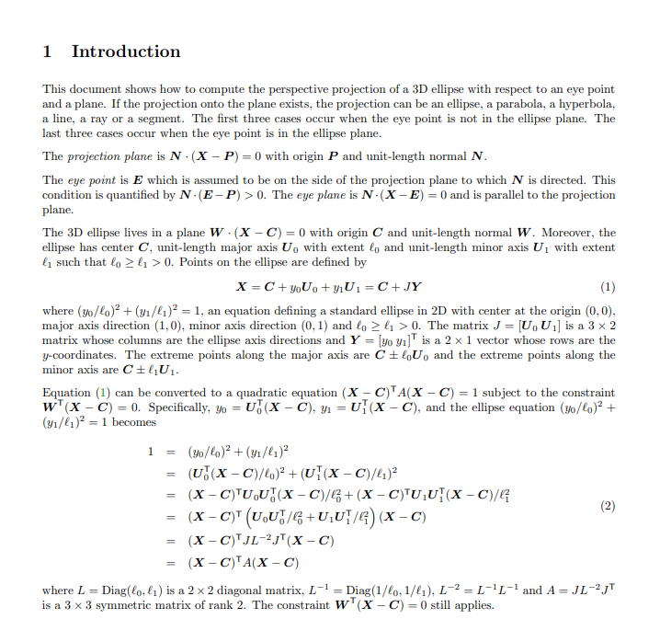
The Math
The perspective projection is a lot of math!
But very tractable.
David Eberly has posted a nice algorithm on his Geometric Tools website.
https://www.geometrictools.com/Documentation/PerspectiveProjectionEllipse.pdf
Perspectively Projecting Orbits Chuck Noble

Slide 9
Fun Facts
When is the projection of an ellipse not an ellipse?
At odd viewing angles, conic section projections can differ in type from the original.
Viewing an elliptical orbit from “inside” the ellipse gives a hyperbolic projection.
Perspectively Projecting Orbits Chuck Noble

Slide 10

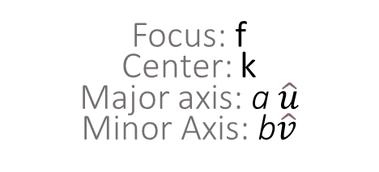
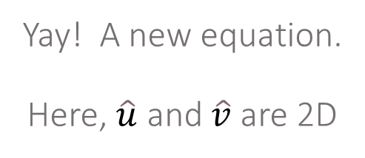
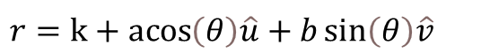
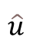
Meanwhile, On the Projection Plane…
Yay! A new equation. Here, $\hat{u}$ and $\hat{v}$ are 2D
$$\hat{v}$$
b
a
f
k
$$\hat{u}$$
$$r=k+acos\left(θ\right)\hat{u}+b\sin\left(θ\right)\hat{v}$$
Focus: f Center: k
Major axis: a $\hat{u}$
Minor Axis: b$\hat{v}$
Perspectively Projecting Orbits Chuck Noble

Slide 11
Unit Vector Projections
Note: The new 2D unit vectors are NOT projections of the 3D unit vectors.
Axes of Unprojected Ellipse
Perspectively Projecting Orbits Chuck Noble

Slide 12
Unit Vector Projections
The axes of the unprojected ellipse are different than the projected ellipse
And of course, the a, b lengths are different, too.
Perspectively Projecting Orbits Chuck Noble

Slide 13
Unit Vector Projections
Axes of Projected Ellipse
Perspectively Projecting Orbits Chuck Noble

Slide 14
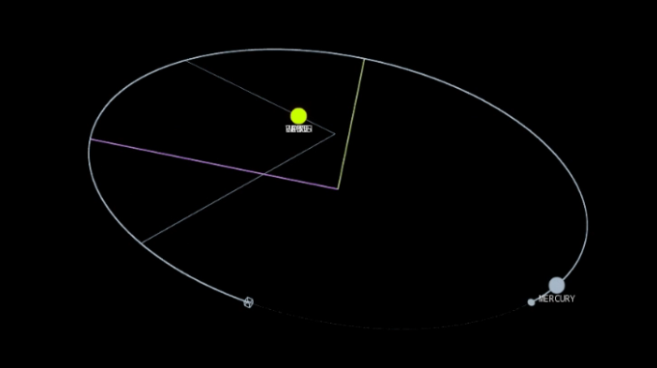
Unit Vector Projections
The difference between unprojected unit vectors (gray) and projected unit vectors (yellow, magenta) in a projection of Mercury’s orbit. Notice how the projected unit vectors are 90 degrees apart. The Semi-Major and Semi-Minor axes distances will differ between unprojected/projected conic sections, as will the center.
Perspectively Projecting Orbits Chuck Noble

Slide 15
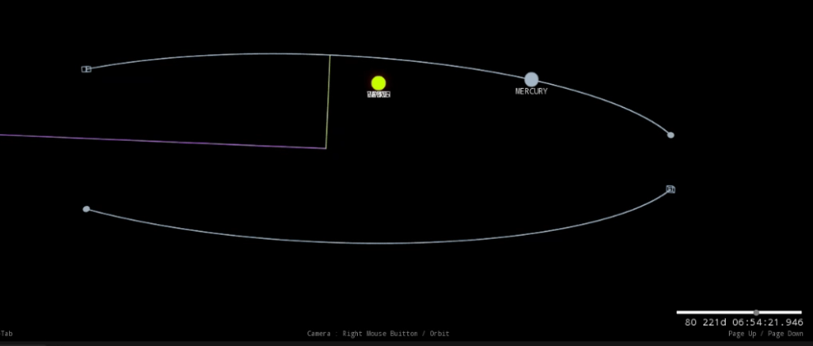
Clipping
Generating a perspective projection is only half the battle.
Each orbit must be clipped against the view frustum so only visible portions of the orbit are tessellated
Zoomed-out projection of Mercury’s obit to make the clipped locations visible.
Perspectively Projecting Orbits Chuck Noble

Slide 16
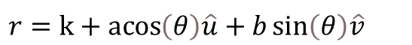

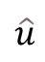
Math in “Clip” Space… ?
x
We could do math in the 2D space of the projection plane. This is also the space a GPU performs clipping.
$$\hat{v}$$
y
$$\hat{u}$$
The clip boundaries are axis aligned.
But it’s still not the most convenient coordinate system for this problem.
$$r=k+acos\left(θ\right)\hat{u}+b\sin\left(θ\right)\hat{v}$$
Perspectively Projecting Orbits Chuck Noble

Slide 17
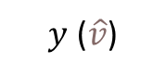
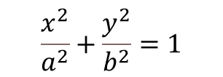
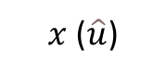
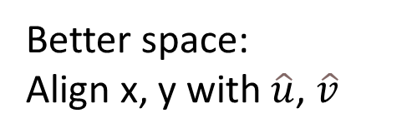


Math in Projection Space
$y$ ($\hat{v}$)
Better space:
Align x, y with $\hat{u}$, $\hat{v}$
Coordinate system transformed into “space” of ellipse axes
The Ellipse
equation is now simple:
$x$ ($\hat{u}$)
$$\frac{x^{2}}{a^{2}}+\frac{y^{2}}{b^{2}}=1$$
Exact equations for line rendering!
x
$$a\cos\left(θ\right)+b\sin\left(θ\right)$$
y
$−b\sin\left(θ\right)+$ $b\cos\left(θ\right)$
Exact solution = no artifacts due to tessellation yet.
No need for any weird curve smoothing or LODing
Perspectively Projecting Orbits Chuck Noble

Slide 18
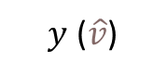
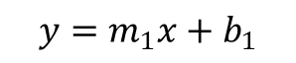

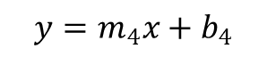
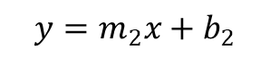
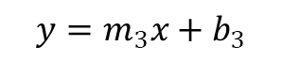
Math in Projection Space
$$y=m_{2}x+b_{2}$$
$y$ ($\hat{v}$)
Coordinate system transformed into “space” of ellipse axes
But… The frustum clip boundaries are no longer axis-aligned.
$x$ ($\hat{u}$)
$$y=m_{3}x+b_{3}$$
$$y=m_{1}x+b_{1}$$
$$y=m_{4}x+b_{4}$$
Perspectively Projecting Orbits Chuck Noble

Slide 19
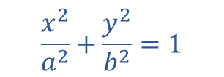

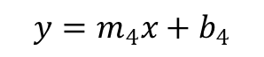
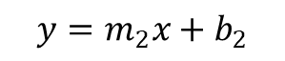
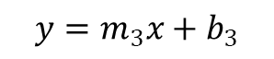
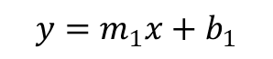

Clipping the conic
Find Intersection of:
$$y=m_{1}x+b_{1}$$
$$\frac{x^{2}}{a^{2}}+\frac{y^{2}}{b^{2}}=1$$
$$y=m_{2}x+b_{2}$$
$$y=m_{3}x+b_{3}$$
$$y=m_{4}x+b_{4}$$
Just a generalized ellipse/line intersection:
$$\frac{x^{2}}{a^{2}}+\frac{y^{2}}{b^{2}}=1$$
$$y=mx+b$$
Trivial to solve by substitution
Perspectively Projecting Orbits Chuck Noble

Slide 20
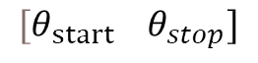

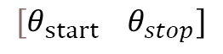




Clipping the conic
Maximum of 4 visible segments
x
$$a\cos\left(θ\right)+b\sin\left(θ\right)$$
y
$−b\sin\left(θ\right)+$ $b\cos\left(θ\right)$
$$[θ_{\operatorname{start}{}}θ_{stop}]$$
1
$$[θ_{\operatorname{start}{}}θ_{stop}]$$
2
$$[θ_{\operatorname{start}{}}θ_{stop}]$$
3
$$[θ_{\operatorname{start}{}}θ_{stop}]$$
4
We just need $θ$ for each intersection.
Perspectively Projecting Orbits Chuck Noble

Slide 21
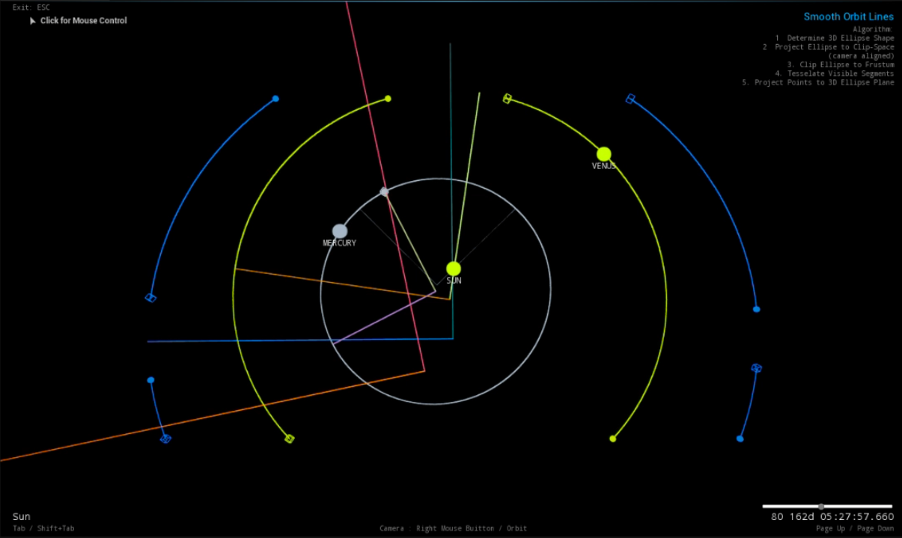
Clipping the conic
Earth’s Orbit, clipped into 4 elliptical segments. Venus with 2 segments. And Mercury as a single, continuous ellipse.

Slide 22
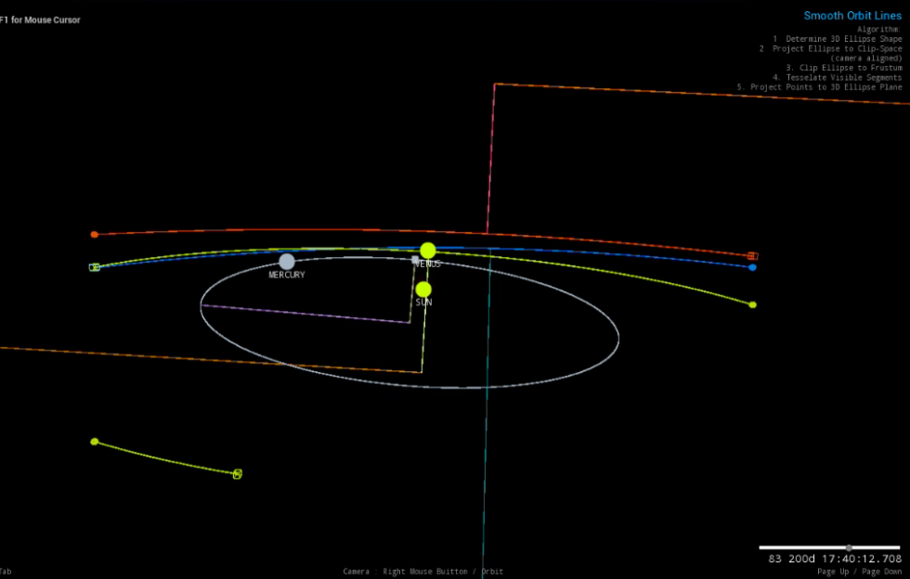
Clipping the conic
Here the projection of Mars’ orbit has become hyperbolic due to the viewpoint location. Mars’ orbit’s focus is located above, outside the orbital ring, indicating it is a hyperbolic projection. This is because the observer is forward of the “backside” of Mars’ orbit.

Slide 23
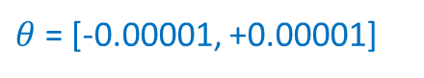
Determining Visible Segments
Exact equations, and bounds on theta, even when only a tiny fraction of the orbits is visible.
$θ$ = [-0.00001, +0.00001]
Tesselation LOD’ed to screen space!
Perspectively Projecting Orbits Chuck Noble

Slide 24
Clipping - Ellipse
For each line If the ellipse does not intersect the line, and it is on the non-visible side, no segments are visible. Skip the orbit
Perspectively Projecting Orbits Chuck Noble

Slide 25
Clipping - Ellipse
For each line If there is only one intersection, it can be handled as if there were no intersections
Perspectively Projecting Orbits Chuck Noble

Slide 26
Clipping - Ellipse
P2
For all other lines (two intersections) Add both intersections to a list
P1
P1, P2
Perspectively Projecting Orbits Chuck Noble

Slide 27
Clipping - Ellipse
Pc1
Pb2
Pb1
Pa2
Pc2
Pa1
List:
Pa1
Pa2
Pb1
Pb2
Pc1
Pc2
Perspectively Projecting Orbits Chuck Noble

Slide 28
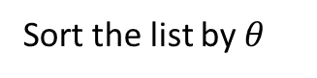
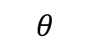
Clipping - Ellipse
Pc1
$$θ$$
Pb2
Pb1
Pa2
Pc2
Pa1
Sort the list by $θ$
Segment:
Anytime one or more lines are in a “not visible state”, the segment is not visible – discard it.
Pa2
Pb1
Pa1
Pb1
Pc1
Pb2
Pc2
Pa2
Segment:
Test Initial Visibility
Pa1
Pc2
Each time the line becomes visible, record it as a segment.
March around the ring, recording how many transitions to the not visible side occur.
Perspectively Projecting Orbits Chuck Noble

Slide 29
Clipping – Ellipse against one line
// Intercept:
// a*cos(t) + b*sin(t) + c == d
template<class T>
bool ClipEllipse(T a, T b, T c, T d, bool& interceptsFustumLine, T& theta1, T& dt1, T& theta2, T& dt2)
{
// https://www.mathcentre.ac.uk/resources/uploaded/mc-ty-rcostheta-alpha-2009-1.pdf
T R = (T)(sqrt(sqr(a) + sqr(b)));
T act = (d - c) / R;
// Is there an intercept? Welp, can we take the arcos of act?
if (act <= (T)1. && act >= (T)-1.)
{
// Yes, there's an intercept! Two, in fact!
// Compute the phase shift
T alpha = (T)atan2((double)b, (double)a);
T arcos = (T)acos(act);
theta1 = alpha + arcos;
theta2 = alpha - arcos;
dt1 = -R * sin(arcos);
dt2 = +R * sin(arcos);
interceptsFustumLine = true;
return true;
}
else
{
interceptsFustumLine = false;
return d * act > 0;
}
return false;
}
Perspectively Projecting Orbits Chuck Noble

Slide 30
This Is What You Came For
Red line = tessellation attempted in 3D space = artifacts
Projecting the conic equation into screen space let’s us avoid this.
Perspectively Projecting Orbits Chuck Noble

Slide 31
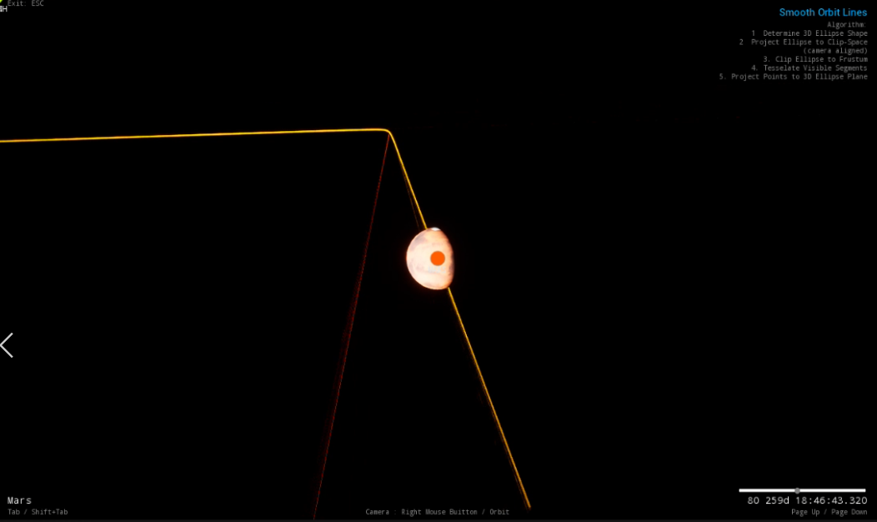
This Is What You Came For
Error between a line tessellated in world space (red) versus screen space (orange).
The orange line consists of fewer, better placed segments, because only the visible portion of the orbit is tessellated.
Perspectively Projecting Orbits Chuck Noble

Slide 32
Score!
The projection’s equation was transformed into gpu “clip” space.
The tessellation is easily done in a compute shader.
Effectively limitless performance/curve LOD.
Perspectively Projecting Orbits Chuck Noble

Slide 33



Beyond Elliptical Orbits
If the orbit becomes hyperbolic, the exact same solution applies, but: cos -> cosh sin -> sinh
$$\frac{x^{2}}{a^{2}}−\frac{y^{2}}{b^{2}}=1$$
x
$$a\cosh\left(θ\right)+b\sinh\left(θ\right)$$
y
$−b\sinh\left(θ\right)+$ $b\cosh\left(θ\right)$
Perspectively Projecting Orbits Chuck Noble

Slide 34
Clipping - Hyperbola
For each line If there are no intersections, and it is on the not visible side, the orbit is not visible. Skip it.
Perspectively Projecting Orbits Chuck Noble

Slide 35
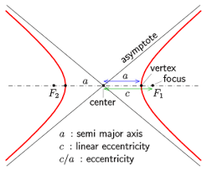
Clipping - Hyperbola
For each line Get the intersection points. For each side, determine if the asymptote points into or away from the visible portion.
Similar to the elliptical case, sort the intersections and determine which segments are visible.
The Hyperbola has two sides, only one of which should be visible. You must test which side intersected the line to make sure it wasn’t the invisible half.
Perspectively Projecting Orbits Chuck Noble

Slide 36
Clipping - Hyperbola
For each line Get the intersection points. For each side, determine if the asymptote points into or away from the visible portion.
Similar to the elliptical case, sort the intersections and determine which segments are visible.
The Hyperbola has two sides, only one of which should be visible. You must test which side intersected the line to make sure it wasn’t the invisible half.
Perspectively Projecting Orbits Chuck Noble

Slide 37
Clipping – Hyperbola against one line
// Solve the quatratic, using the '-' discriminant
T q = (-B_quad - sqrt(d)) / (2. * A_quad);
// what does the quadratic yield? the point intersection point (x(y), y).
y = q;
// knowing y, we can resolve z...
x = (-B * y - C) / A;
// (Rinse)
// We only care about the hyperbola in the same side as (x,y)...
// Any -sign*x < 0 intersections are on the mirrored hyperbola, which is of no interest
// to us in this use case.
if (sign * x >= 0)
// Intersetction at: {x, y}
points[n++] = atanh(y / x * a / b);
// (Repeat.)
// using the '+' discriminant
q = (-B_quad + sqrt(d)) / (2. * A_quad);
y = q;
x = (-B * y - C) / A;
if (sign * x >= 0)
points[n++] = atanh(y / x * a / b);
}
else if (d == 0)
{
// This case only happens if the intersection is a tangent...
// In the case of a tanget, a hyperbola never crosses the line...
// So, we don't care about this case.... as the hyperbola will never
// need clipped here.
}
else if (d < 0)
{
// There are no real roots, to the quadratic, which means the line does
// not intersect the hyperbola at all.
}
return n;
}
// Hyperbola:
// sqr(x)/sqr(a) - sqr(y)/sqr(b) = 1
//
// Line:
// A*x + B*y = C
template<class T>
int BisectHyperbola(T A, T B, T C, bool positiveOrientation, T a, T b, bool& initiallyHidden, T(&points)[2])
{
double sign = positiveOrientation ? +1. : -1;
// The intersection is solved by a simple quadratic equation....
// (Easily derived by substititing the line equation into the hyperbola eq)
T A_quad = sqr(B) - sqr(a * A / b);
T B_quad = 2 * B * C;
T C_quad = sqr(C) - sqr(a * A);
T d = sqr(B_quad) - 4. * A_quad * C_quad;
int n = 0;
const Vector<2, T> lineNormal({ A, B });
// First Asymptote
const Vector<2, T> asymptote({ sign * a, -sign * b });
// Does the first asymptote cross INTO the hidden side? If so, it starts off hidden
// By definition, the lines have a positive cross product in this case...
// Which means their normal vector points towards the hidden side...
// Which means the dot product of it and another line will be positive if it's heading off to the hidden side
initiallyHidden = Dot(lineNormal, asymptote) > 0;
// if the discriminant is > 0, there's two real roots
if (d > 0)
{
// But only one of them is against the x>0 half of the hyperbola we care about...
T x, y;
Perspectively Projecting Orbits Chuck Noble

Slide 38
Orbital Elements to Conic Section
Great! So, how do we get the conic shape of the orbit to begin with?
For starters, the orbital plane is defined by a ZXZ rotation matrix, which is computed from:
Inclination
Longitude of Ascending Node
Argument of Periapsis
// Computes the rotation matrix per the conic elements
// (RHS Coordinate System, Perifocal to Inertial Planetocentric Frame)
void MakeQ(double inc, double lnode, double argp, RotationMatrix& q)
{
inc *= pi<double> / 180.;
lnode *= pi<double> / 180.;
argp *= pi<double> / 180.;
// Orbital Mechanics for Engineering Students (Eq. 4.47)
EulerAngles<double> R313 = EulerAngles<double>(2, 0, 2, argp, inc, lnode);
Rotation<3, double> r = Rotation<3, double>(R313);
q = Transpose((RotationMatrix)r);
}
The u, v unit vectors are the columns of this matrix.
Perspectively Projecting Orbits Chuck Noble

Slide 39
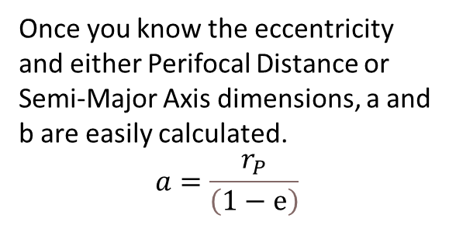
Orbital Elements to Conic Section
Once you know the eccentricity and either Perifocal Distance or Semi-Major Axis dimensions, a and b are easily calculated.
$$a=\frac{r_{P}}{\left(1−ⅇ\right)}$$
void ComputeGeometry(const FConicElements& ConicElements, FOscullatingOrbitGeometry& Geometry)
{
Matrix3x3<double> Q;
MakeQ(ConicElements.inc, ConicElements.lnode, ConicElements.argp, Q);
Geometry.a = ConicElements.rp / (1 - ConicElements.ecc);
// Could just grab the first column...
Geometry.p_hat = Q.GetCol(0);
// Semi-Minor Axis
Geometry.b = Geometry.a * sqrt(1 - ConicElements.ecc * ConicElements.ecc);
Geometry.q_hat = Q.GetCol(1);
// Orbital plane normal
Geometry.w_hat = Q.GetCol(2);
Geometry.ae = Geometry.a * ConicElements.ecc;
}
Again, the u, v unit vectors are the columns of this matrix.
Perspectively Projecting Orbits Chuck Noble

Slide 40
Sample Code
Working/Sample implementation
Implemented in Unreal Engine 5
For GitHub repo access, just request it :).
The sample uses the Geometric Tools Library by David Eberly
(However, the production version is based on SPICE/MaxQ and Compute Shaders.)
Perspectively Projecting Orbits Chuck Noble

Slide 41
Sample Code

Slide 42
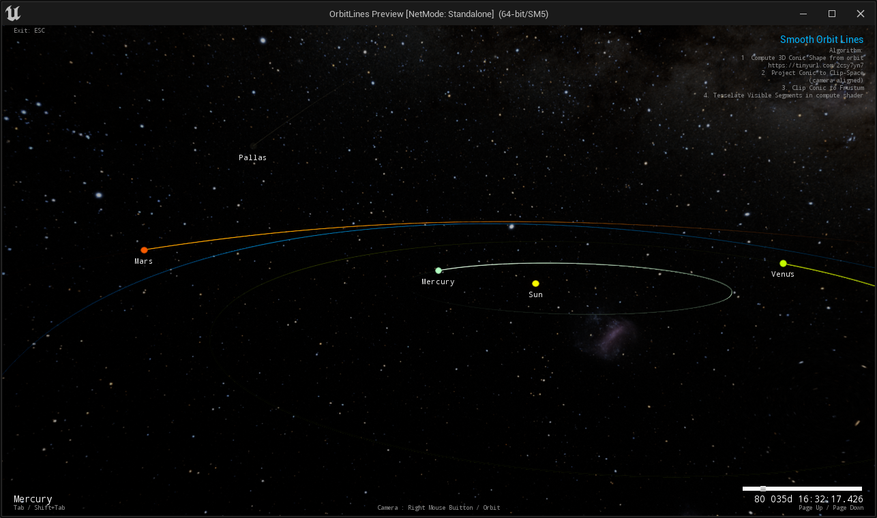
Sample Code

Slide 43
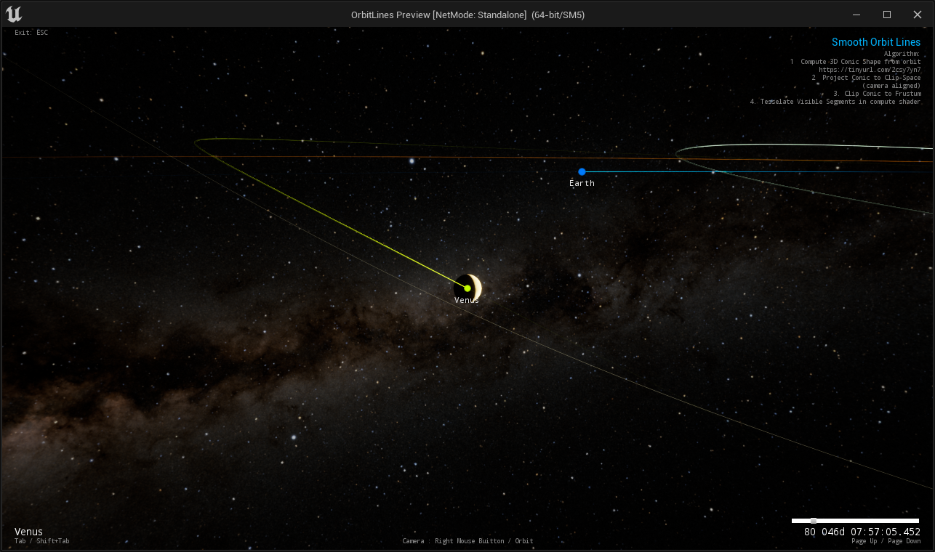
Sample Code

Slide 44
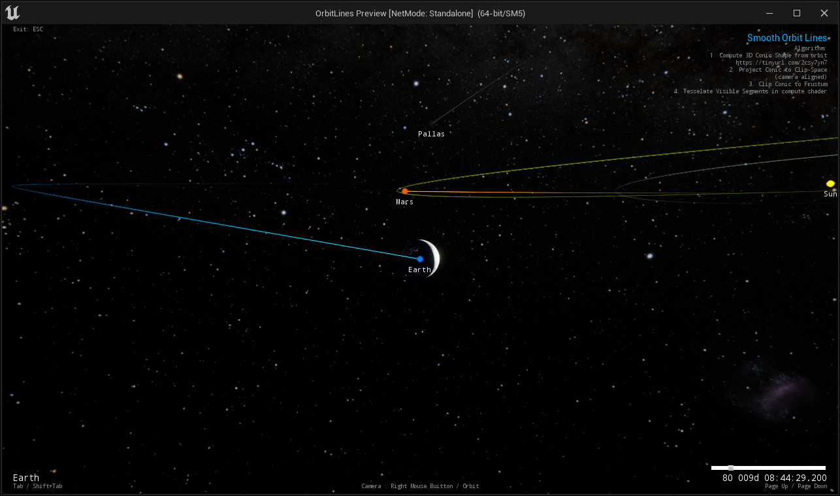
Sample Code

Slide 45
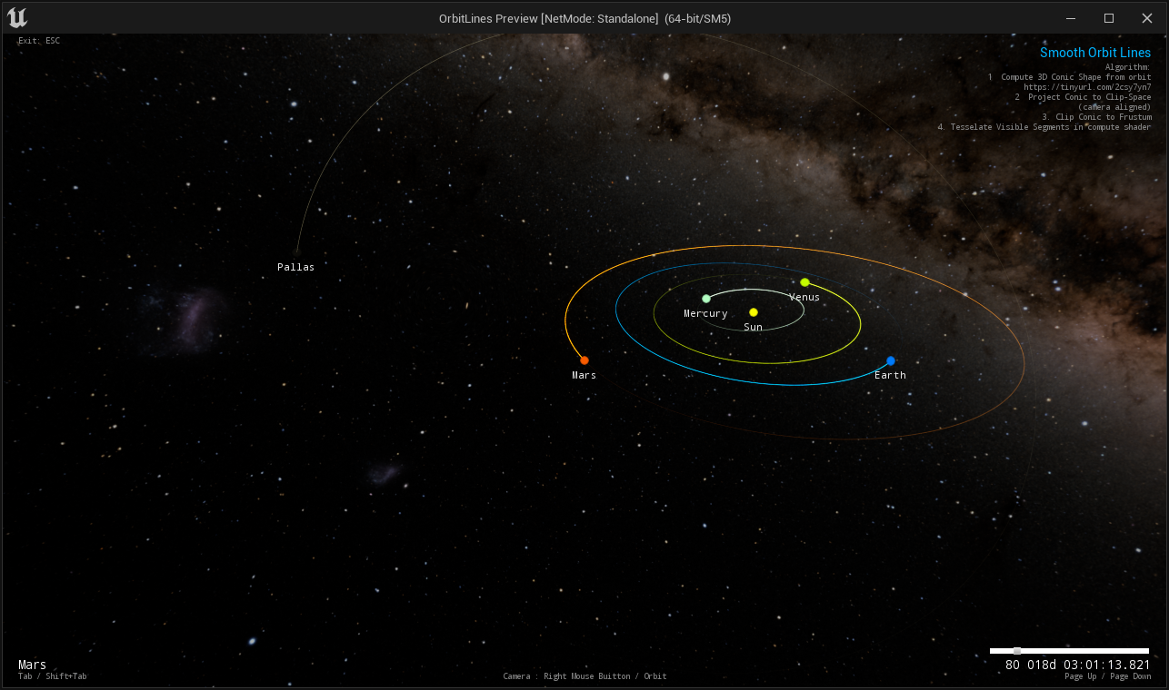
Sample Code

Slide 46
Thanks
Special Thanks to David Eberly
For assistance and revisiting the perspective projection algorithm.
David has posted an updated projection algorithm here: https://www.geometrictools.com/Documentation/PerspectiveProjectionEllipse.pdf
Perspectively Projecting Orbits Chuck Noble

Slide 47
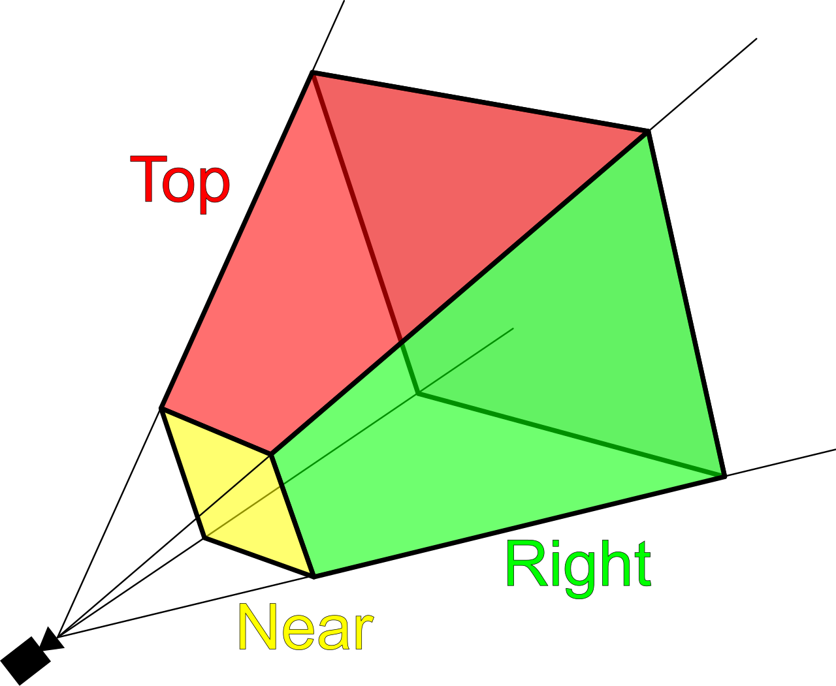
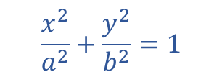

We can tesselate the curve in screen space into a clean line. But first we’ll need to know what sections of the orbit are visible.
Find Intersection of:
$$y=m_{1}x+b_{1}$$
$$\frac{x^{2}}{a^{2}}+\frac{y^{2}}{b^{2}}=1$$
$$y=m_{2}x+b_{2}$$
$$y=m_{3}x+b_{3}$$
$$y=m_{4}x+b_{4}$$
Just a generalized ellipse/line intersection:
$$\frac{x^{2}}{a^{2}}+\frac{y^{2}}{b^{2}}=1$$
$$y=mx+b$$
Trivial to solve by algebraic substitution!
Perspectively Projecting Orbits Chuck Noble

Slide 48

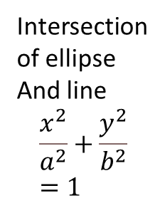
$$\frac{x^{2}}{a^{2}}+\frac{y^{2}}{b^{2}}=1$$
Intersection of ellipse
And line
$$\frac{x^{2}}{a^{2}}+\frac{y^{2}}{b^{2}}=1$$
Perspectively Projecting Orbits Chuck Noble

Slide 49



Coordinate system transformed into “space” of ellipse axes
The Ellipse
equation is simple
$$\frac{x^{2}}{a^{2}}+\frac{y^{2}}{b^{2}}=1$$
Exact equations for line rendering!
x
$$a\cos\left(θ\right)+b\sin\left(θ\right)$$
y
$−b\sin\left(θ\right)+$ $b\cos\left(θ\right)$
Perspectively Projecting Orbits Chuck Noble

Slide 50
Perspectively Projecting Orbits Chuck Noble

Slide 51
Perspective Projection
3D Scene
+
Perspective Projection
=
Projection on 2D Plane

